Slide 1
TOPAS Basic Course
2017.07.19
SUMP Lab
by Sang Hee AHN

Slide 2
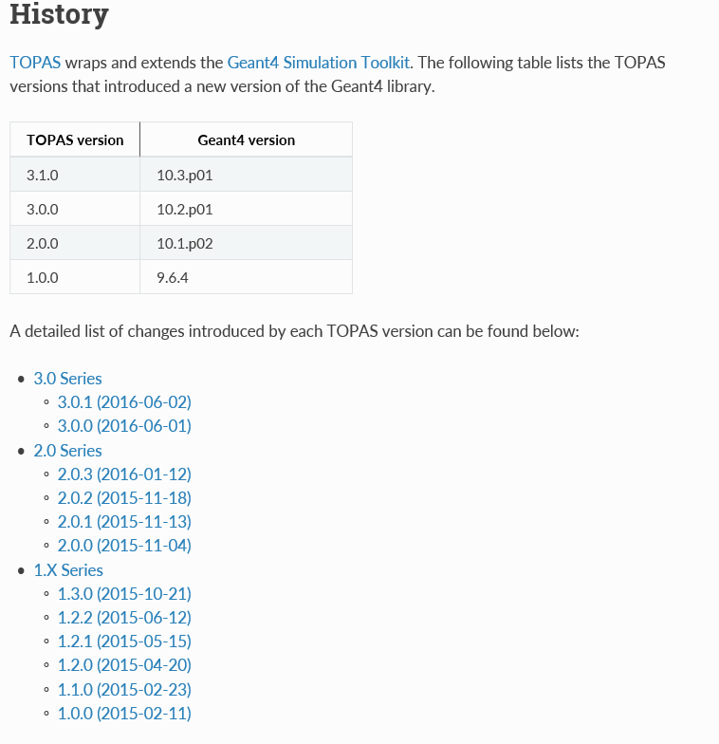
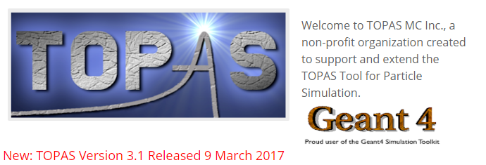
TOPAS Tool for particle simulation
TOPAS manual (wiki)
http://topas.readthedocs.io/en/latest/
http://www.topasmc.org/(official)

Slide 3
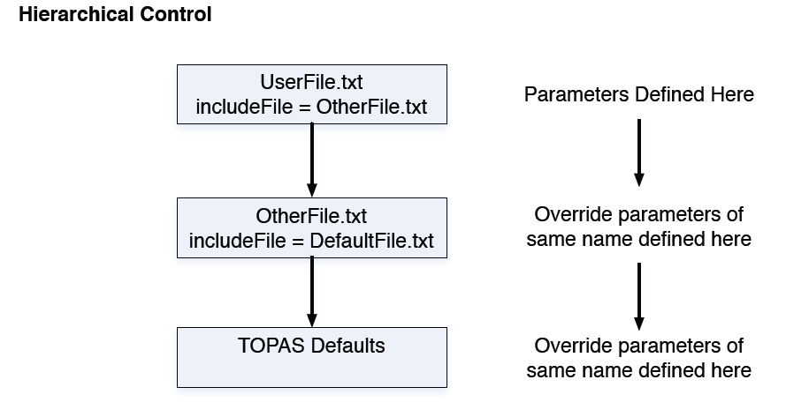
The TOPAS Parameters System

Slide 4
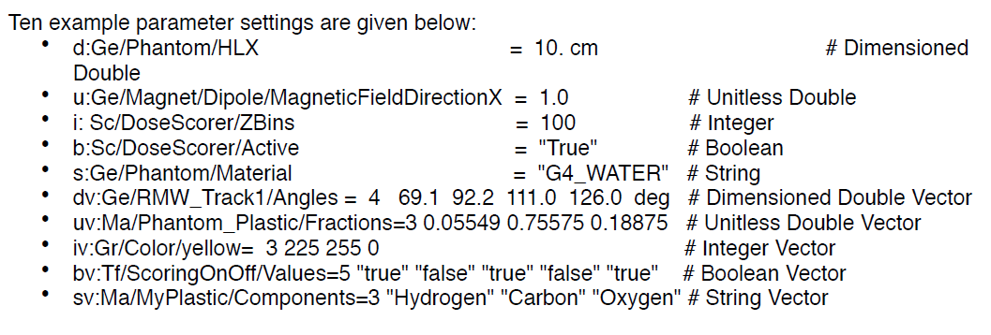
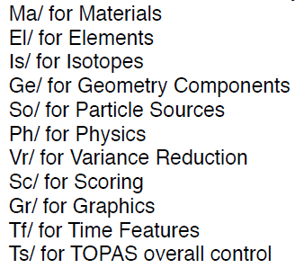
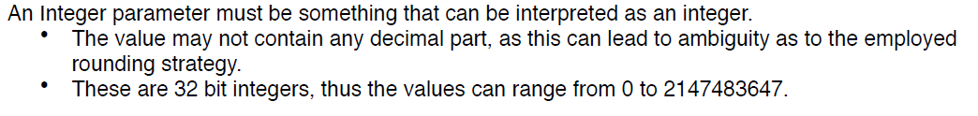
The TOPAS Parameters System

Slide 5
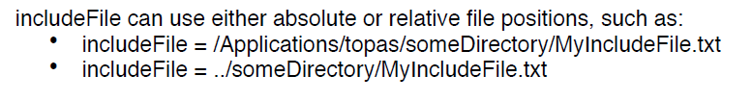

The TOPAS Parameters System

Slide 6
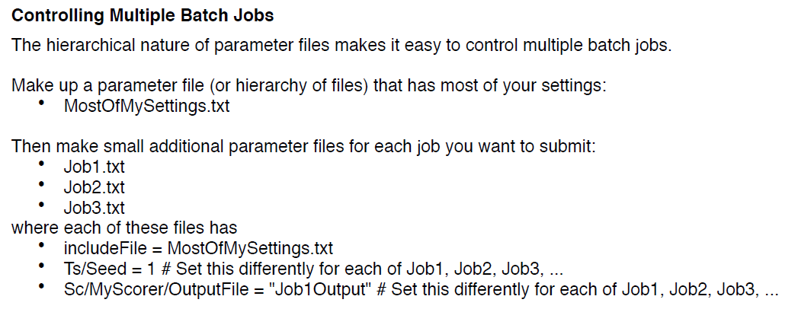
The TOPAS Parameters System

Slide 7
Installation

Slide 8
Installation( Ubuntu)
Debian Users: Install the following:
apt-get install libexpat1-dev
apt-get install libgl1-mesa-dev
apt-get install libglu1-mesa-dev
apt-get install libxt-dev
apt-get install xorg-dev
apt-get install build-essential

Slide 9
Installation(Ubuntu)
Data package (Physics)
wget http://geant4.cern.ch/support/source/G4EMLOW.6.50.tar.gz
wget http://geant4.cern.ch/support/source/G4NDL.4.5.tar.gz
wget http://geant4.cern.ch/support/source/G4PhotonEvaporation.4.3.2.tar.gz
wget http://geant4.cern.ch/support/source/G4RadioactiveDecay.5.1.1.tar.gz
wget http://geant4.cern.ch/support/source/G4SAIDDATA.1.1.tar.gz
wget http://geant4.cern.ch/support/source/G4NEUTRONXS.1.4.tar.gz
wget http://geant4.cern.ch/support/source/G4PII.1.3.tar.gz
wget http://geant4.cern.ch/support/source/RealSurface.1.0.tar.gz
wget http://geant4.cern.ch/support/source/G4ABLA.3.0.tar.gz
wget http://geant4.cern.ch/support/source/G4ENSDFSTATE.2.1.tar.gz
wget http://geant4.cern.ch/support/source/G4TENDL.1.3.tar.gz

Slide 10
Installation( Ubuntu)
Debian Users: Install the following:
$ tar -zxvf topas_3_1_*.tar.gz
$ cd topas
$ unzip Geant4Headers.zip
$ ccmake ./
$ make –j 4(number thread)

Slide 11
Installation( Ubuntu)
$ gedit Start_topas.sh
#!/bin/bash
export G4LEDATA=~/G4Data/G4EMLOW6.50
export G4NEUTRONHPDATA=~/G4Data/G4NDL4.5
export G4LEVELGAMMADATA=~/G4Data/PhotonEvaporation4.3.2
export G4RADIOACTIVEDATA=~/G4Data/RadioactiveDecay5.1.1
export G4SAIDXSDATA=~/G4Data/G4SAIDDATA1.1
export G4NEUTRONXSDATA=~/G4Data/G4NEUTRONXS1.4
export G4PIIDATA=~/G4Data/G4PII1.3
export G4REALSURFACEDATA=~/G4Data/RealSurface1.0
export G4ABLADATA=~/G4Data/G4ABLA3.0
export G4ENSDFSTATEDATA=~/G4Data/G4ENSDFSTATE2.1
export G4TENDLDATA=~/G4Data/G4TENDL1.3
export LD_LIBRARY_PATH=~/topas/libexternal/:$LD_LIBRARY_PATH
echo “Topas_3.1 Run Ready !!”

Slide 12
Run TOPAS
../topas mysimulationfile.txt

Slide 13
Basic Geometry

Slide 14
Open-gl Visualization command
http://geant4.slac.stanford.edu/Presentations/vis/G4OpenGLTutorial/G4OpenGLTutorial.html
Idle>
/vis/viewer/rest
/vis/viewer/set/zoom 2 : zoom in
/vis/viewer/set/zoom 2 : zoom out
/vis/viewer/set/viewpointThetaPhi 30 30 : view point
/vis/viewer/panTo 1 0 : center position reference
/vis/viewer/set/style surface
/vis/viewer/set/wireframe
/vis/open OGL

Slide 15
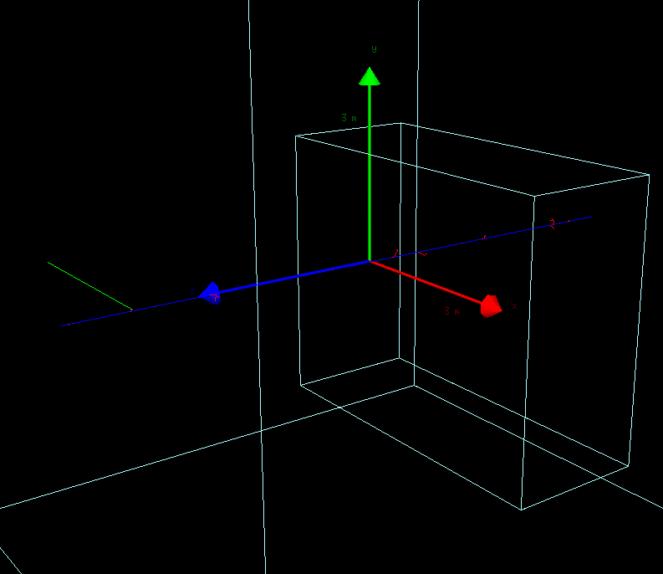
Basic Geometry – Box
$ gedit OneBox.txt
s:Ge/MyBox/Type = "TsBox"
s:Ge/MyBox/Material = "Air"
s:Ge/MyBox/Parent = "World"
d:Ge/MyBox/HLX = 2.5 m
d:Ge/MyBox/HLY = 2. m
d:Ge/MyBox/HLZ = 1. m
d:Ge/MyBox/TransX = 2. m
d:Ge/MyBox/TransY = 0. m
d:Ge/MyBox/TransZ = 0. m
d:Ge/MyBox/RotX = 0. deg
d:Ge/MyBox/RotY = 0. deg
d:Ge/MyBox/RotZ = 0. deg
sv:Ph/Default/Modules = 1 "g4em-standard_opt0"
s:Gr/ViewA/Type = "OpenGL"
i:Gr/ViewA/WindowSizeX = 1024
i:Gr/ViewA/WindowSizeY = 768
b:Gr/ViewA/IncludeAxes = "True"
d:Gr/ViewA/Theta = 55 deg
d:Gr/ViewA/Phi = 20 deg
s:Gr/ViewA/Projection = "Perspective"
d:Gr/ViewA/PerspectiveAngle = 30 deg
u:Gr/ViewA/Zoom = 2.
b:Ts/PauseBeforeQuit = "True“
$ ../topas OneBox.txt

Slide 16
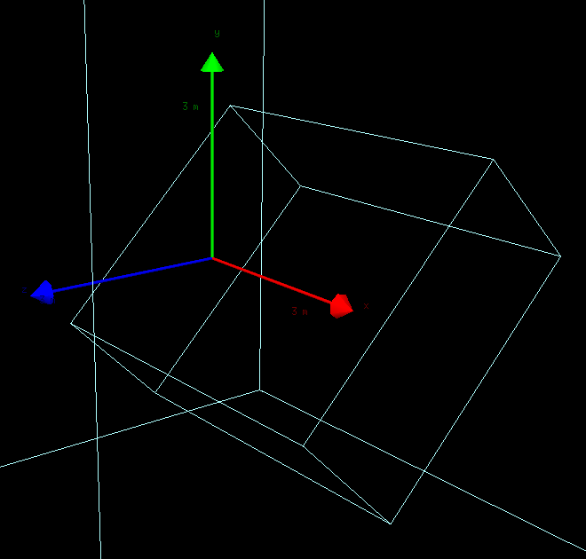
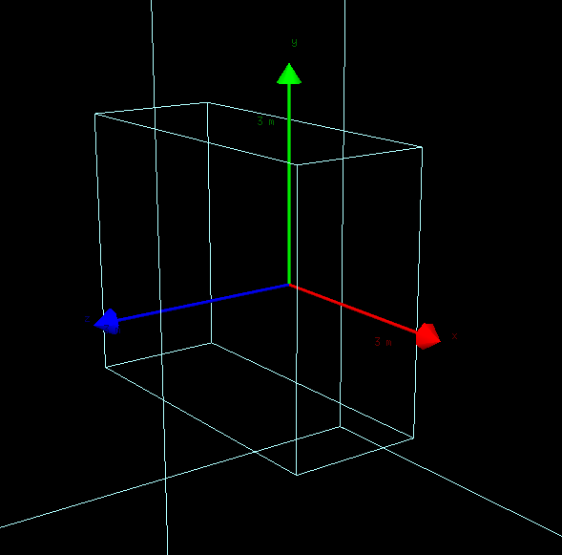
Basic Geometry – Box
$ geidt OneBoxRoation.txt
# Demonstrates use of includeFile.
# Overrides the RotX value from OneBox.txt
includeFile = OneBox.txt
d:Ge/MyBox/RotX = 45. deg
$ geidt OneBoxTranslation.txt
# Demonstrates use of includeFile.
# Translates box by a value of -0.5 times the value
# of TransX that was inherited from the includeFile.
includeFile = OneBox.txt
d:Ge/MyBox/TransX = inheritedValue m * -0.5

Slide 17
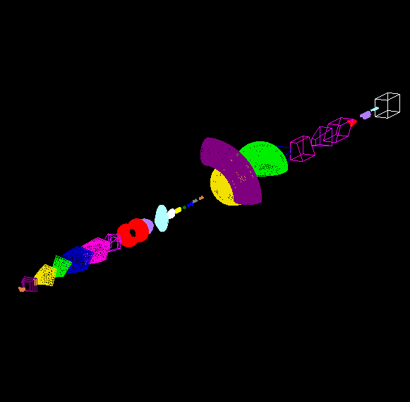
Basic Geometry extra Geometry
Example/Basic
$ ../topas ShapeTestWithAllParameters.txt

Slide 18
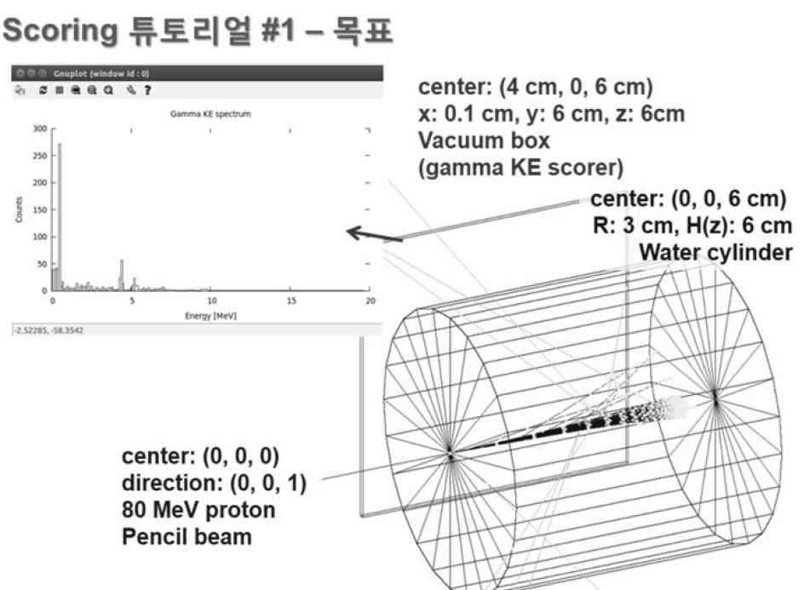
Hands-on 01

Slide 19
Hands-on 01
$ gedit Beamparameter.txt
$ gedit Scoring
$ gedit Geometry.txt
$ gedit Visu.txt
$ gedit Mymain.txt

Slide 20
Hands-on 01- Geometry
includeFile = Scoring.txt
# World #
s:Ge/World/Material = "Vacuum"
d:Ge/World/HLX = 1.0 m
d:Ge/World/HLY = 1.0 m
d:Ge/World/HLZ = 1.0 m
b:Ge/World/Invisible = "True"

Slide 21
Hands-on 01- Geometry
# WaterCylinder #
s:Ge/WaterCylinder/Parent="World"
s:Ge/WaterCylinder/Type="TsCylinder"
s:Ge/WaterCylinder/Material="G4_WATER"
d:Ge/WaterCylinder/RMin=0.0 cm
d:Ge/WaterCylinder/RMax=1.5 cm
d:Ge/WaterCylinder/HL=3.0 cm
d:Ge/WaterCylinder/SPhi=0. deg
d:Ge/WaterCylinder/DPhi=360. deg
d:Ge/WaterCylinder/TransX=0. cm
d:Ge/WaterCylinder/TransY=0. cm
d:Ge/WaterCylinder/TransZ=0. cm
d:Ge/WaterCylinder/RotX=0. deg
d:Ge/WaterCylinder/RotY=0. deg
d:Ge/WaterCylinder/RotZ=0. deg
i:Ge/WaterCylinder/RBins = 1
i:Ge/WaterCylinder/PhiBins = 1
i:Ge/WaterCylinder/ZBins = 1
s:Ge/WaterCylinder/Color = "blue"

Slide 22
Hands-on 01- Geometry
# Flat Detector #
s:Ge/Flat_Detector/Type = "TsBox"
s:Ge/Flat_Detector/Parent = "World"
s:Ge/Flat_Detector/Material = "G4_AIR"
d:Ge/Flat_Detector/HLX = 0.05 cm
d:Ge/Flat_Detector/HLY = 3.0 cm
d:Ge/Flat_Detector/HLZ = 3.0 cm
d:Ge/Flat_Detector/TransX = 3. cm
d:Ge/Flat_Detector/TransY = 0. cm
d:Ge/Flat_Detector/TransZ = 0. cm
s:Ge/Flat_Detector/Color = "red"
i:Ge/Flat_Detector/XBins = 1
i:Ge/Flat_Detector/YBins = 1
i:Ge/Flat_Detector/ZBins = 1
s:Ge/Flat_Detector/DrawingStyle = "Wireframe"

Slide 23
Hands-on 01-Beamparameter
includeFile = Geometry.txt
i:Ts/Seed = 1
i:Ts/NumberOfThreads = 4
# Beam Parameter #
s:Ge/MyBeamGroup/Parent = "World"
s:Ge/MyBeamGroup/Type = "Group"
d:Ge/MyBeamGroup/TransX = 0. cm
d:Ge/MyBeamGroup/TransY = 0. cm
d:Ge/MyBeamGroup/TransZ = 10. cm
d:Ge/MyBeamGroup/RotX = 0. deg
d:Ge/MyBeamGroup/RotY = 180. deg
d:Ge/MyBeamGroup/RotZ = 0. deg

Slide 24
Hands-on 01-Beamparameter
s:So/MyBeam/Type = "Beam" # Beam, Isotropic, Emittance or PhaseSpace
s:So/MyBeam/Component = "MyBeamGroup"
s:So/MyBeam/BeamParticle = "proton"
d:So/MyBeam/BeamEnergy = 80 MeV
u:So/MyBeam/BeamEnergySpread = 0.757504
s:So/MyBeam/BeamPositionDistribution = "Gaussian" # Flat or Gaussian
s:So/MyBeam/BeamPositionCutoffShape = "Ellipse" # Point, Ellipse, Rectangle or Isotropic
d:So/MyBeam/BeamPositionCutoffX = 0.1 cm
d:So/MyBeam/BeamPositionCutoffY = 0.1 cm
d:So/MyBeam/BeamPositionSpreadX = 0.1 cm
d:So/MyBeam/BeamPositionSpreadY = 0.1 cm
s:So/MyBeam/BeamAngularDistribution = "Gaussian" # Flat or Gaussian
d:So/MyBeam/BeamAngularCutoffX = 90. deg
d:So/MyBeam/BeamAngularCutoffY = 90. deg
d:So/MyBeam/BeamAngularSpreadX = 0.0032 rad
d:So/MyBeam/BeamAngularSpreadY = 0.0032 rad
i:So/MyBeam/NumberOfHistoriesInRun = 10000
i:Ts/ShowHistoryCountAtInterval = 10000

Slide 25
Hands-on 01-Beamparameter
# My Physics List #
s:Ph/ListName = "MyPhysics"
b:Ph/ListProcesses = "False" # Set true to dump list of active physics processes to console
s:Ph/MyPhysics/Type= "Geant4_Modular"
sv:Ph/MyPhysics/Modules = 6 "g4em-standard_opt4" "g4h-phy_QGSP_BIC_HP" "g4decay" "g4ion-binarycascade" "g4h-elastic_HP" "g4stopping"

Slide 26
Hands-on 01-Scoring
includeFile = Visu.txt
# MyScoring #
s:Sc/MyScoring/Quantity = "PhaseSpace"
b:Sc/MyScoring/OutputToConsole = "True"
s:Sc/MyScoring/Surface = "Flat_Detector/XMinusSurface"
s:Sc/MyScoring/OutputType = "ASCII" # ASCII, Binary, Limited or ROOT
s:Sc/MyScoring/OutputFile = "./Python_Hist_Reading/Output"
s:Sc/MyScoring/Component = "Flat_Detector"
i:Sc/MyScoring/OutputBufferSize = 10000
#sv:Sc/MyScoring/OnlyIncludeParticlesNamed = 1 "gamma"
s:Sc/MyScoring/IfOutputFileAlreadyExists = "Overwrite"

Slide 27
Hands-on 01-Visu
# Visulaization #
s:Gr/ViewA/Type = "OpenGL"
i:Gr/ViewA/WindowSizeX = 1024
i:Gr/ViewA/WindowSizeY = 768
b:Gr/ViewA/IncludeAxes = "True"
d:Gr/ViewA/AxesSize = 0.1 m
d:Gr/ViewA/Theta = 30 deg
d:Gr/ViewA/Phi = 30 deg
#s:Gr/ViewA/Projection = "Perspective"
#d:Gr/ViewA/PerspectiveAngle = 30 deg
#u:Gr/ViewA/Zoom = 3.

Slide 28
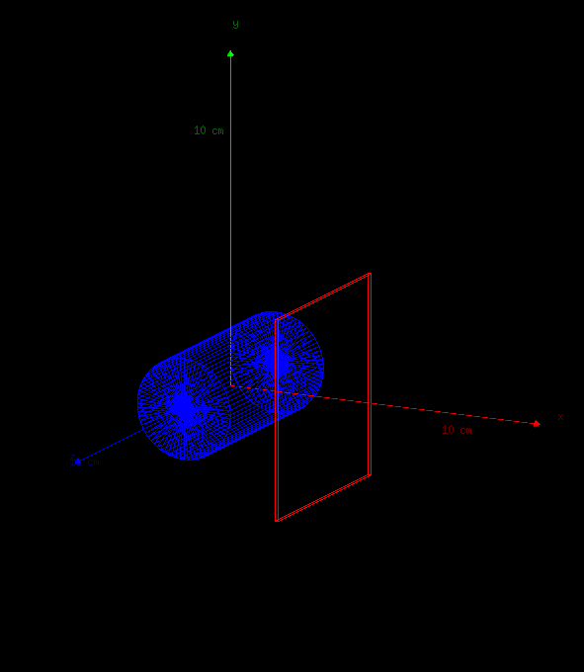
Hands-on 01-MyMain
includeFile = Beamparameter.txt
#b:Ts/PauseBeforeQuit = "True"
b:Ts/PauseBeforeSequence = "True"
$ ../topas MyMain.txt

Slide 29
Hands-on 01-Analysis
sudo apt-get install python-matplotlib
sudo pip install numpy
sudo apt-get install python-numpy python-scipy
$ cd Python _Analysis
$ python Phsp2csvFile.py
% python Myhist.py

Slide 30
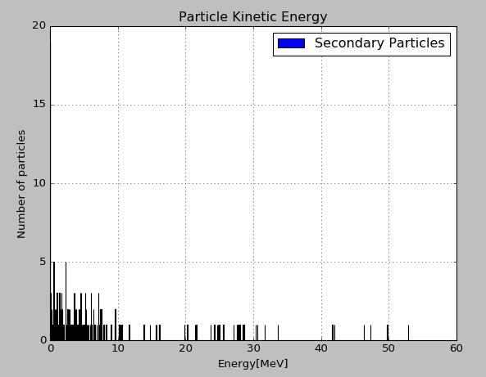
Hands-on 01 Results of Simulation

Slide 31


Slide 32
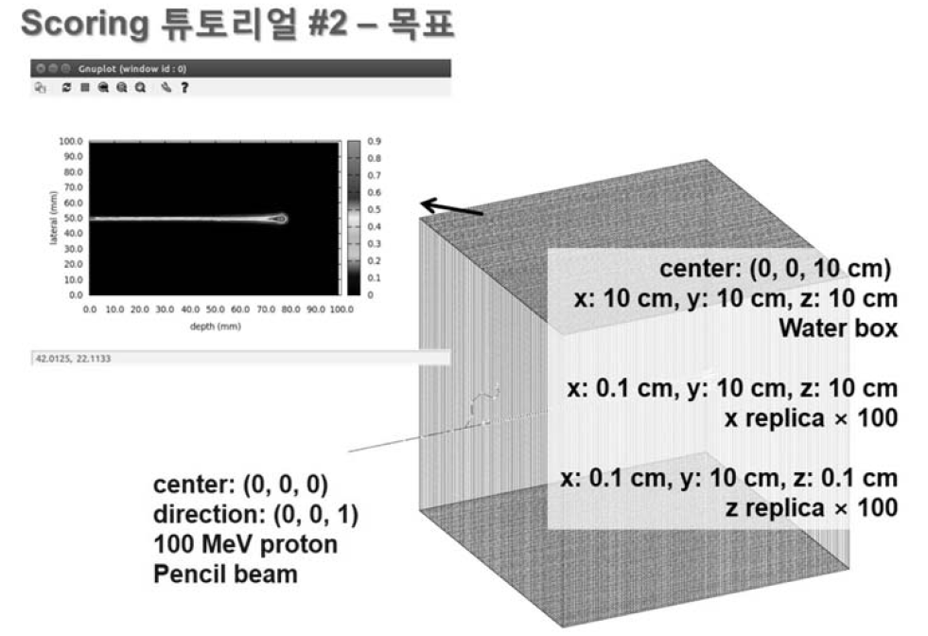
Hands-on 02

Slide 33
Hands-on 02-Geometry
includeFile = Scoring.txt
# World #
s:Ge/World/Material = "Vacuum"
d:Ge/World/HLX = 1.0 m
d:Ge/World/HLY = 1.0 m
d:Ge/World/HLZ = 1.0 m
b:Ge/World/Invisible = "True"

Slide 34
Hands-on 02-Geometry
# WaterPhantom 15 x 15 x 15 cm#
s:Ge/WaterPhantom/Type = "TsBox"
s:Ge/WaterPhantom/Parent = "World"
s:Ge/WaterPhantom/Material = "G4_WATER"
d:Ge/WaterPhantom/HLX = 15 cm
d:Ge/WaterPhantom/HLY = 15 cm
d:Ge/WaterPhantom/HLZ = 15 cm
d:Ge/WaterPhantom/TransX = 0. cm
d:Ge/WaterPhantom/TransY = 0. cm
d:Ge/WaterPhantom/TransZ = 0. cm
s:Ge/WaterPhantom/Color = "blue"
i:Ge/WaterPhantom/XBins = 1
i:Ge/WaterPhantom/YBins = 1
i:Ge/WaterPhantom/ZBins = 1
s:Ge/WaterPhantom/DrawingStyle = "Wireframe"

Slide 35
Hands-on 02-Scroing
includeFile = Visu.txt
# MyScoring #
s:Sc/MyScorer/Quantity = "EnergyDeposit"
#s:Sc/MYScorer/Quantity = "DoseToWater"
#s:Sc/MyScorer/Quantity = "Fluence"
#s:Sc/MYScorer/Quantity = "ProtonLET"
s:Sc/MyScorer/Component = "WaterPhantom"
#b:Sc/DoseAtPhantom/OutputToConsole = "TRUE"
s:Sc/MyScorer/IfOutputFileAlreadyExists = "Overwrite"
s:Sc/MyScorer/OutputType = "csv＂ #binary , root
i:Sc/MyScorer/XBins = 1
i:Sc/MyScorer/YBins = 300
i:Sc/MyScorer/ZBins = 300
s:Sc/MYScorer/OutputFile = "./Python_Dose_Reading/Output"

Slide 36
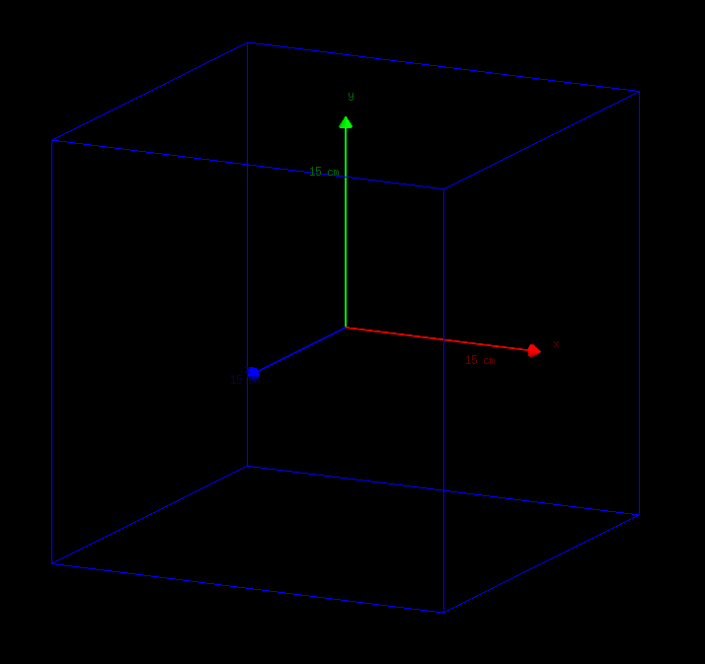
Hands-on 01-MyMain
includeFile = Beamparameter.txt
#b:Ts/PauseBeforeQuit = "True"
b:Ts/PauseBeforeSequence = "True"
$ ../topas MyMain.txt

Slide 37
Hands-on 01-Analysis
$ cd Python _Analysis
$ python Dose_Map_Reading_TOPAS.py

Slide 38
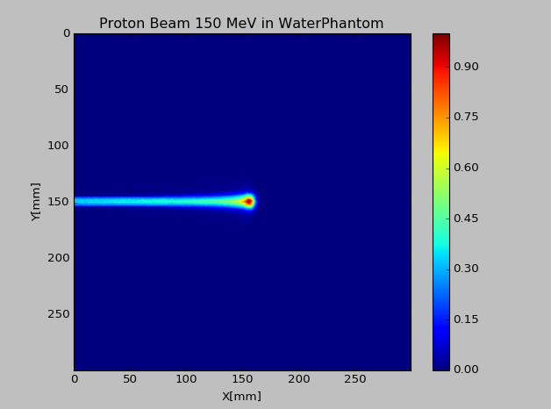
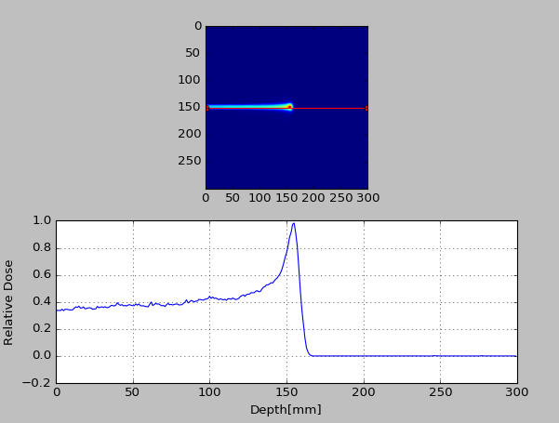
Hands-on 02 Results of Simulation

Slide 39
Additional TIP

